Slide 1
Introduction to Functional Programming with F#

Slide 2
What’s coming
Imperative vs Declarative programming
Characteristics of Functional Programming
Working with F#

Slide 3
Imperative vs Declarative programming

Slide 4
Imperative programming is a programming paradigm that uses statements that change a program's state.
Notes:
Imperative program consists of commands for the computer to perform.
Imperative programming focuses on:
describing how a program operates
how to execute
defines control flow as statements that change a program state.
In much the same way that the imperative mood in natural languages expresses commands, an imperative program consists of commands for the computer to perform.
The concepts behind object-oriented programming attempt to extend this approach.

Slide 5
Declarative programming expresses the logic of computation without describing its control flow.
Notes:
Programming is done with expressions or declarations instead of statements.
Declarative programming:
focuses on what to execute
defines program logic but not detailed control flow
In functional programming we are defining terms, not giving orders.

Slide 6
Characteristics of Functional Programming

Slide 7
Characteristics of Functional Programming
Immutability
Pure functions
Functions as first class citizens (higher order functions)
Currying and Partial Application
Pipeline operator
Pattern matching

Slide 8
Immutability
In Functional Programming we do not change state
Functions return new value
Value threaded between function calls
Notes:
If you need new value you use a function which will calculate that value for you
You can thread value between function calls to aggregate or compare
You can hide `complexities` of keeping state using monads (and computation expressions in F#)
Pros of immutability:
Programs are less complicated and easier to reason about
No need for defensive copies of objects
Easy to test
Good for sharing information between threads in a multi-threaded environment since they don't need to be synchronized

Slide 9
Pure functions
Always gives the same output value for a given input value
Have no side effects
If the result of a pure expression is not used, it can be removed without affecting other expressions.
If a pure function is called with arguments that cause no side-effects, the result is constant with respect to that argument list
Notes:
Benefits of pure functions:
They’re easier to reason about
They’re easier to combine
They’re easier to test
They’re easier to debug
They’re easier to parallelize

Slide 10
Functions as first class citizens
Functions are treated as any other type in programming language
Functions can be passed as arguments
Functions can be returned as a result
Higher order functions
Notes:
A higher-order function is a function that does at least one of the following:
takes one or more functions as arguments (i.e. procedural parameters),
returns a function as its result.

Slide 11
Currying and Partial Application
If you supply fewer than the specified number of arguments, you create a new function that expects the remaining arguments.
Notes:
Currying is the technique of translating the evaluation of a function that takes multiple arguments into evaluating a sequence of functions, each with a single argument.
Partial application is the process of fixing a number of arguments to a function, producing another function of smaller arity.

Slide 12
Currying and Partial Application
Reuse in multiple contexts
Fixing function parameters
“plug in” behaviour (dependency injection)

Slide 13
Pipeline operator |>
Output of one function is used as input to another function
Similar to method chains
LINQ lambda expressions
Great for building DSL
Notes:
Allows to put the function argument in front of the function rather than after.

Slide 14
Pattern matching
Provides flexible and powerful way of testing data against a series of conditions and performing some computations based on the condition met.
Patterns condense a lot of decision-making power into little space without sacrificing readability.
Notes:
More complex pattern matching:
OR / AND
CONS, list, array
Type test

Slide 15
Working with F#

Slide 16
Value and function bindings
A binding associates an identifier with a value or function
value bindings let i = 1
function bindings let add1 i = i + 1 let add a b = a + b
Notes:
Functions are bound in exactly same way as values
No parentheses for function arguments !

Slide 17
Tuples
Tuples are groups of unnamed but ordered values
(1, 2, 3) // Tuple of ints.
("one", 2.0) // Tuple that has mixed types.
(a + 1, b + 1) // Tuple of integer expressions.
struct (1.025f, 1.5f) // Struct Tuple of floats

Slide 18
Tuples as function arguments
let add (a, b) = a + b
Use pattern matching to obtain individual values
Uncurried function -> no partial application!

Slide 19
Unit type
Every F# expression must evaluate to a value.
let print = printfn “Hello World!”
val print : unit
let getThree() = 3
val getThree: unit -> int

Slide 20
Working in F#
Like C# and VB.NET, F# lets you write all kinds of applications:
Project libraries
Console applications
Web Applications
Windows forms applications
Mobile apps
Notes:
F# supports full .NET Framework as well as .NET Core
Because F# compiles to .NET IL code, you can use F# libraries in any .NET language (F#, C#, VB.Net) and you can use any .NET library in F#!
Visual Studio solutions can be a mixture of projects in F#, C#, VB.NET etc.

Slide 21
F# Interactive
F# Interactive (fsi.exe) allows to run code interactively or execute F# scripts.
REPL is great for quick scripting (with support for 64-bit architecture)
Built-in into Visual Studio and VS Code
Easy to reference any .NET assembly

Slide 22
When to use F#
Notes:
Multithreaded applications
Domain modelling; DSL
Scripting
Testing – Property Based Testing

Slide 23
Resources

Slide 24
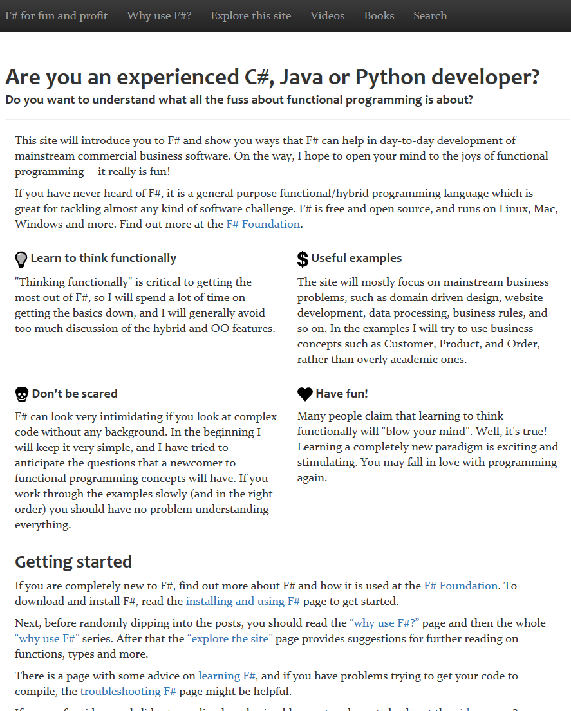
https://fsharpforfunandprofit.com/
From basic to advanced F#

Slide 25
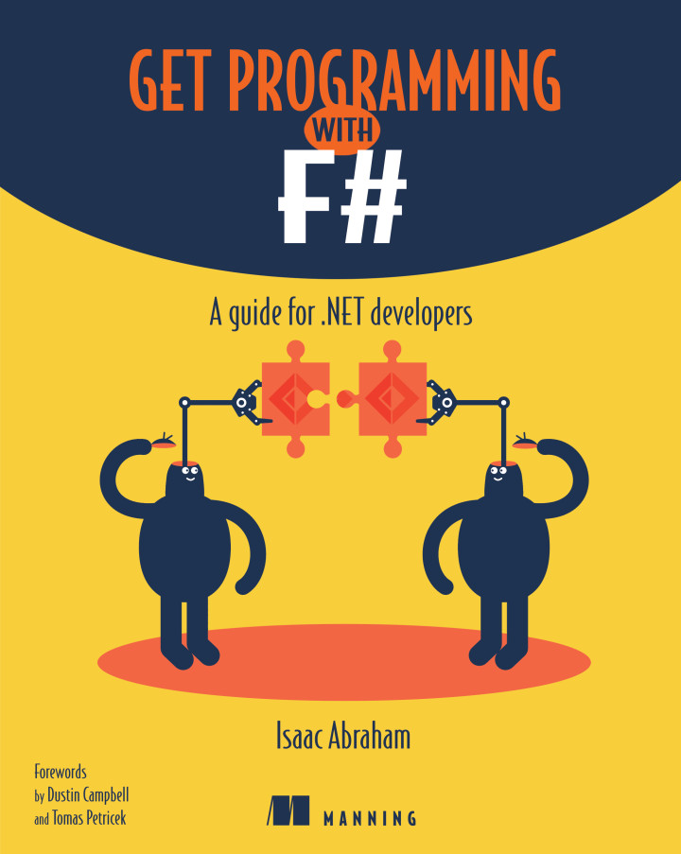
Get Programming with F#
Great introductory book when you are starting with F#

Slide 26
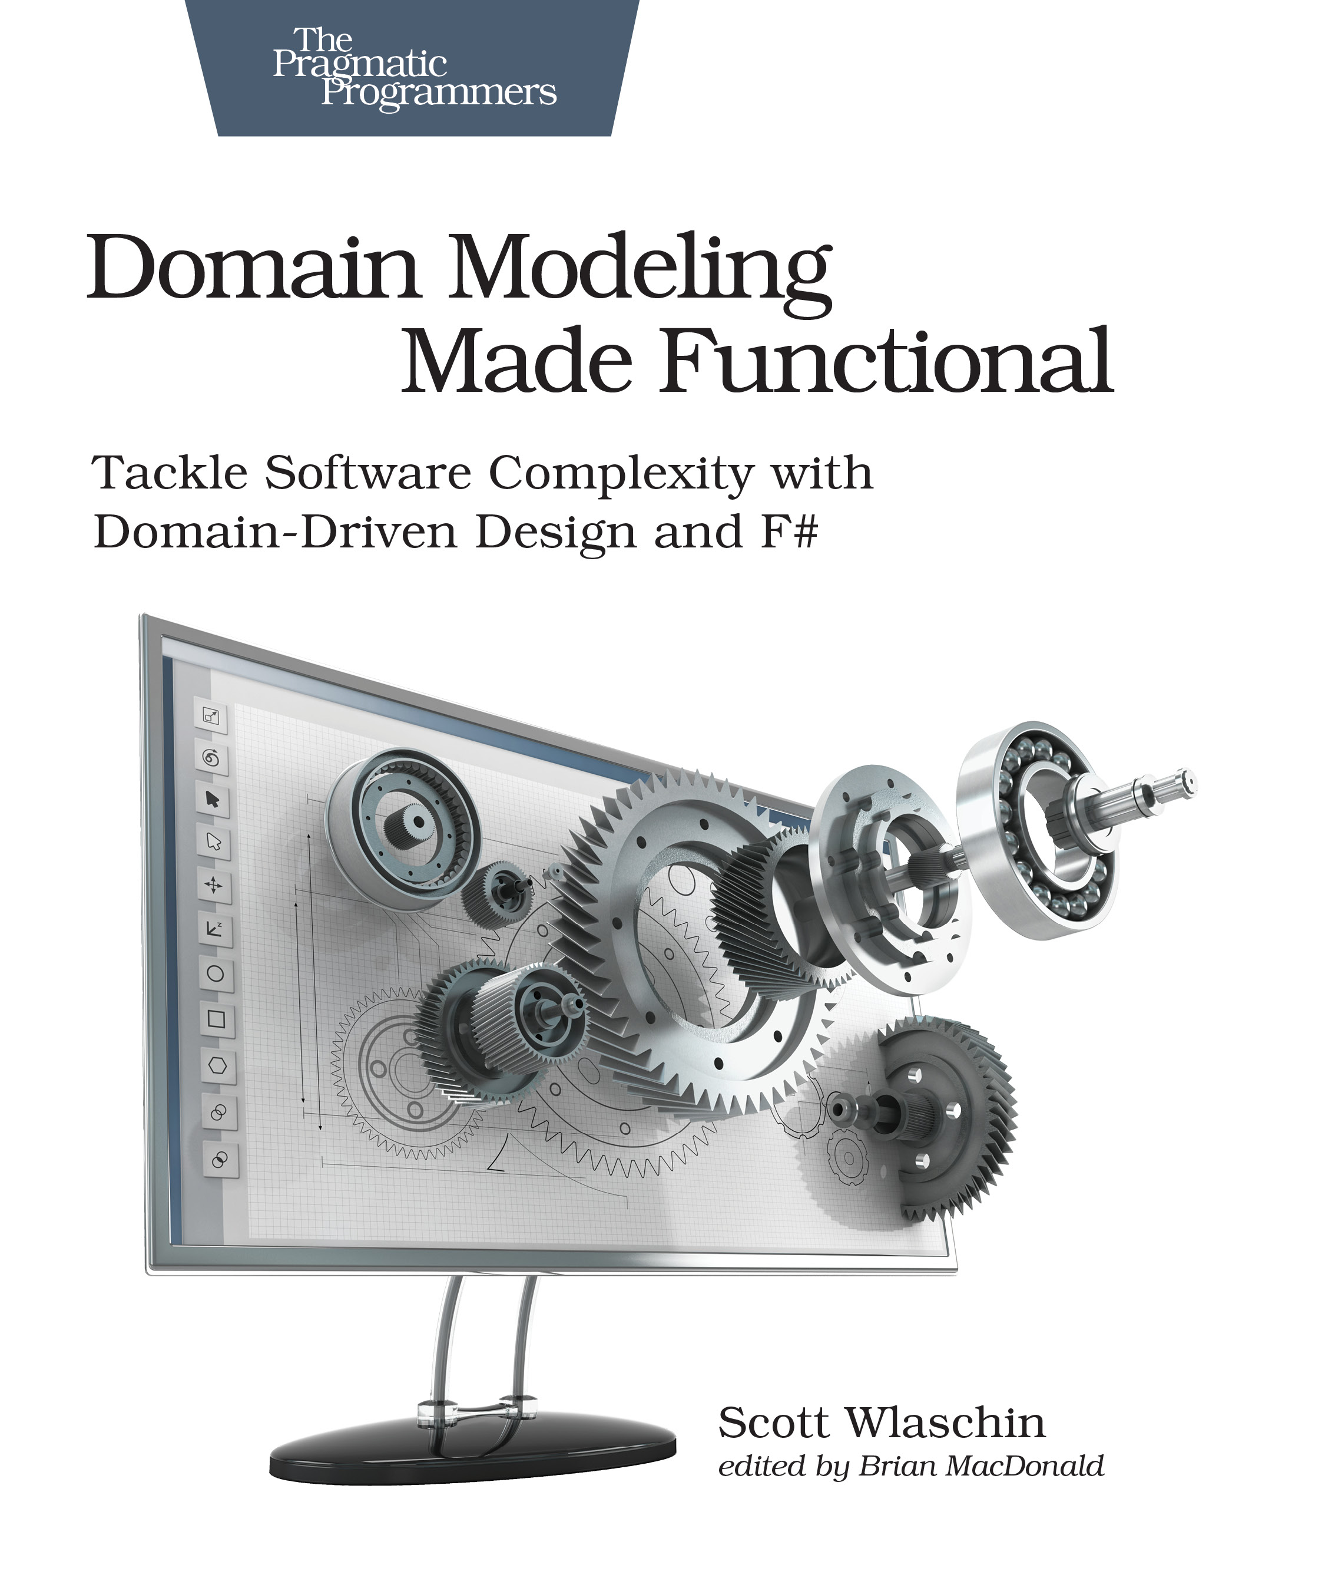
Domain Modeling Made Functional
Modelling complex domains with F#

Slide 27
Thanks!
ANY QUESTIONS?
https://github.com/mariuszwojcik

